Slide 1


大模型系列 – 大模型算法
打破 Transformer
ZOMI

Slide 2
关于本内容
Transformer 结构回顾与挑战
RWKV 新结构
Mamba 新结构
未来打破 Transformer 路在何方

Slide 3
01
RWKV

Slide 4
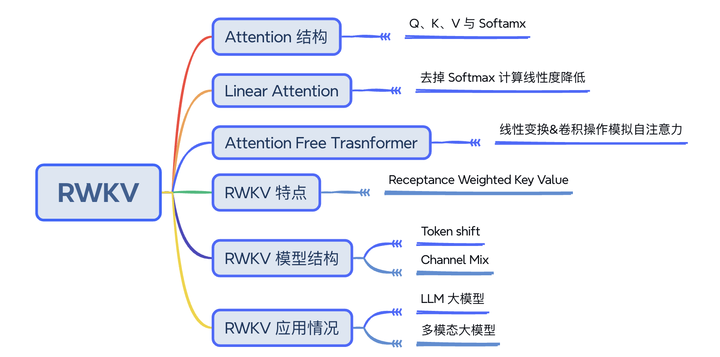
RWKV

Slide 5
RWKV

Slide 6
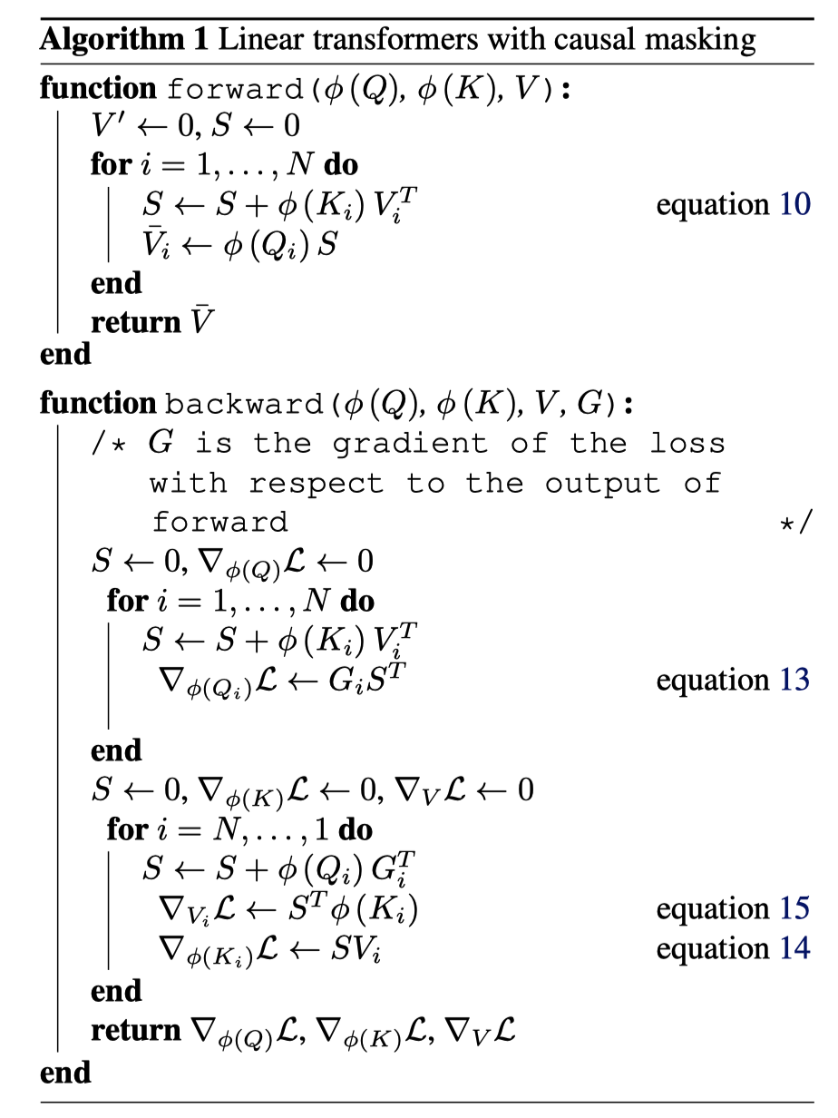
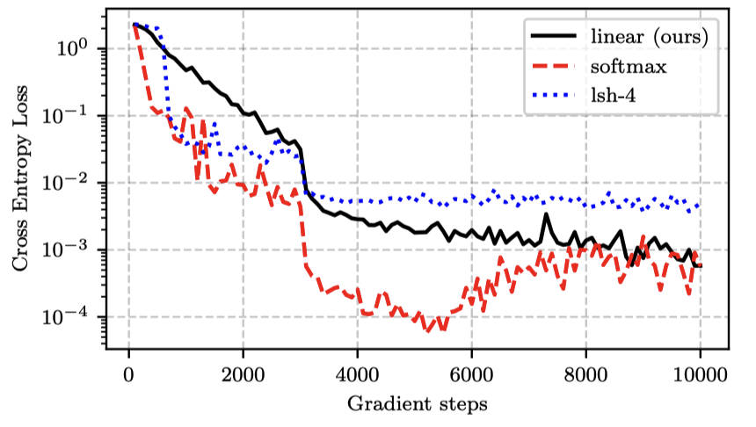
Linear Attention
Transformers are rnns: Fast autoregressive transformers with linear attention.

Slide 7
RWKV

Slide 8
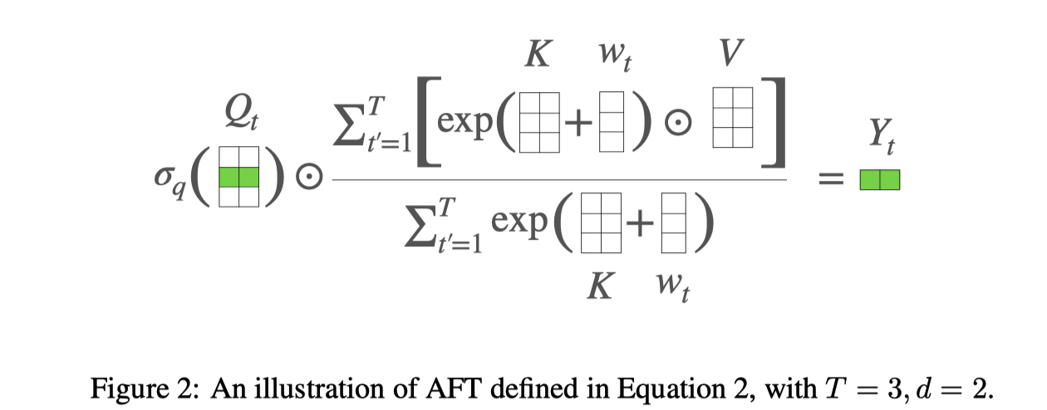
AFT
Paper：An attention free transformer.

Slide 9
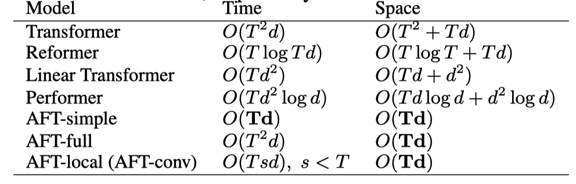
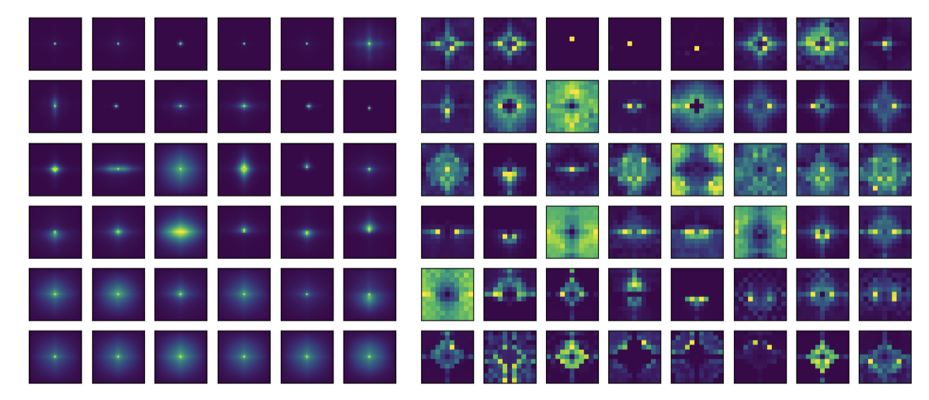
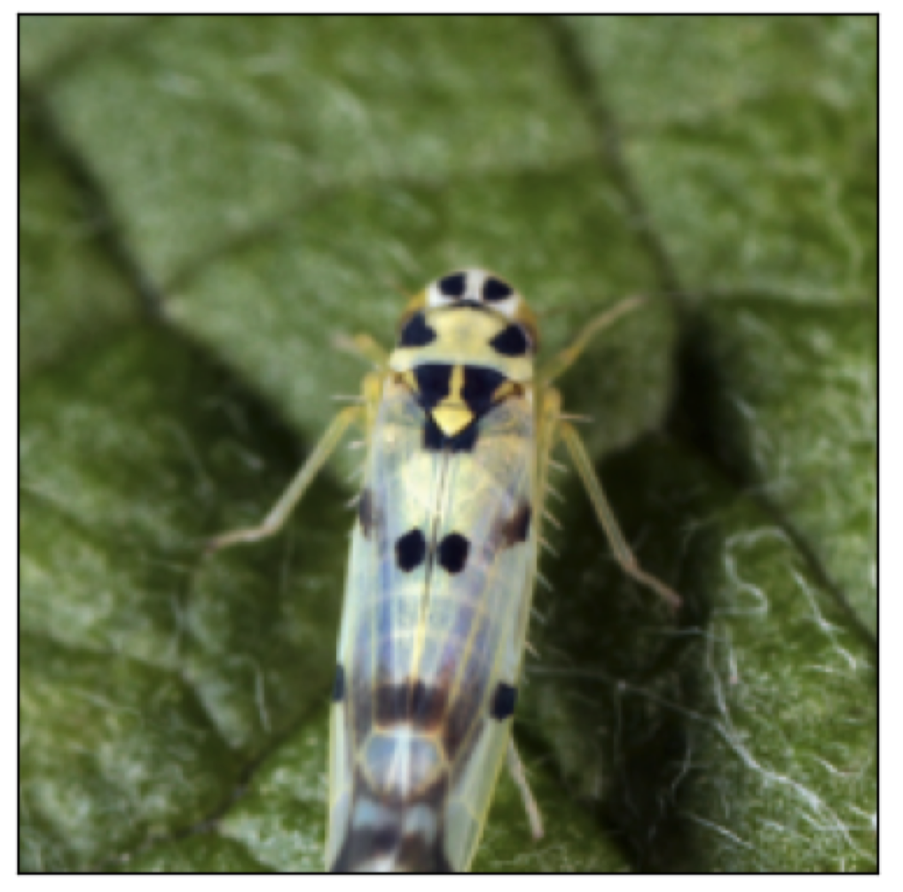
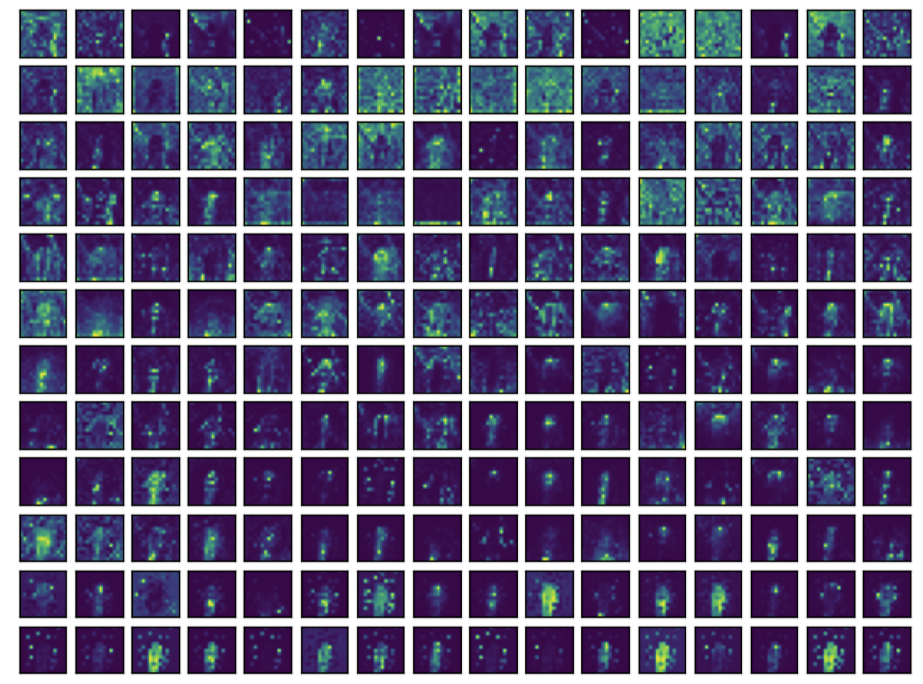
AFT
Paper：An attention free transformer.

Slide 10
RWKV

Slide 11
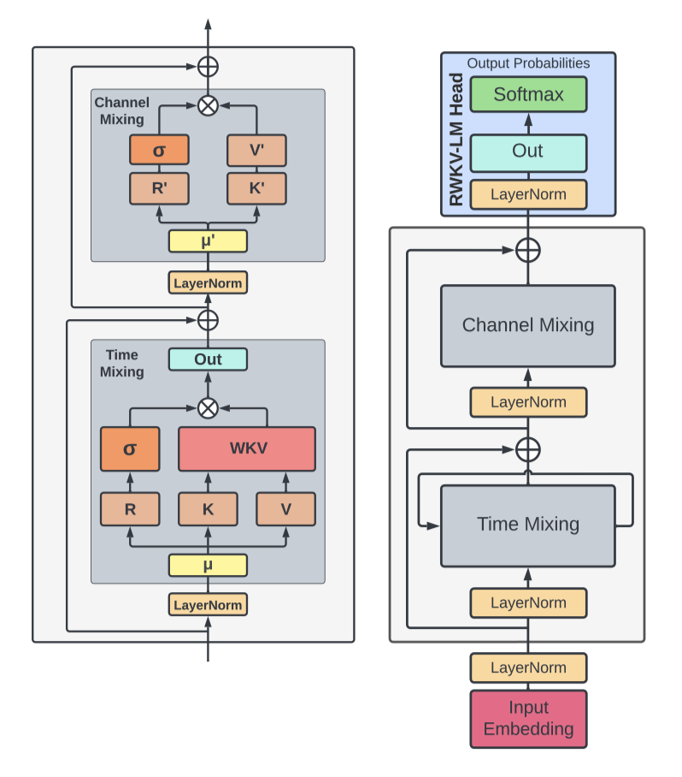
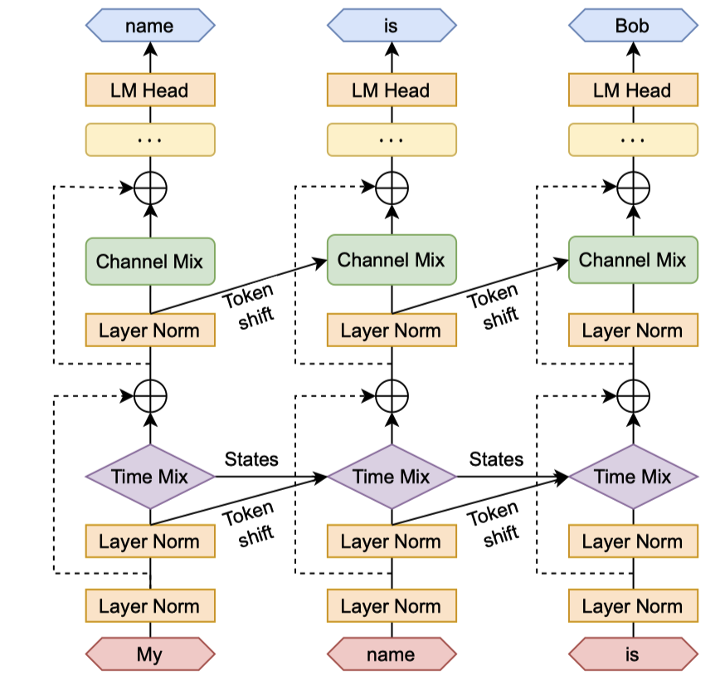
RWKV
RWKV: Reinventing RNNs for the Transformer Era

Slide 12
Reference 参考&引用
https://arxiv.org/abs/2006.16236
https://www.rwkv.com/
https://arxiv.org/abs/2105.14103
https://github.com/BlinkDL/RWKV-LM
https://wiki.rwkv.com/

Slide 13
02
Mamba

Slide 14
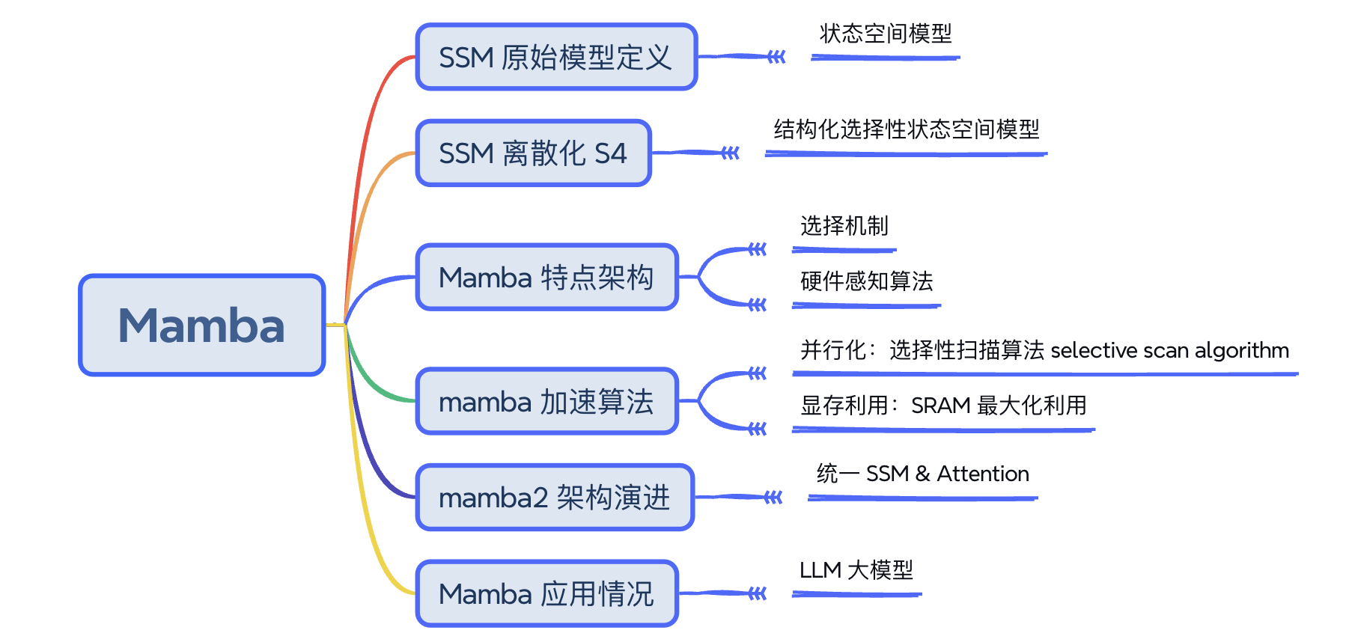
Mamba

Slide 15
Mamba

Slide 16
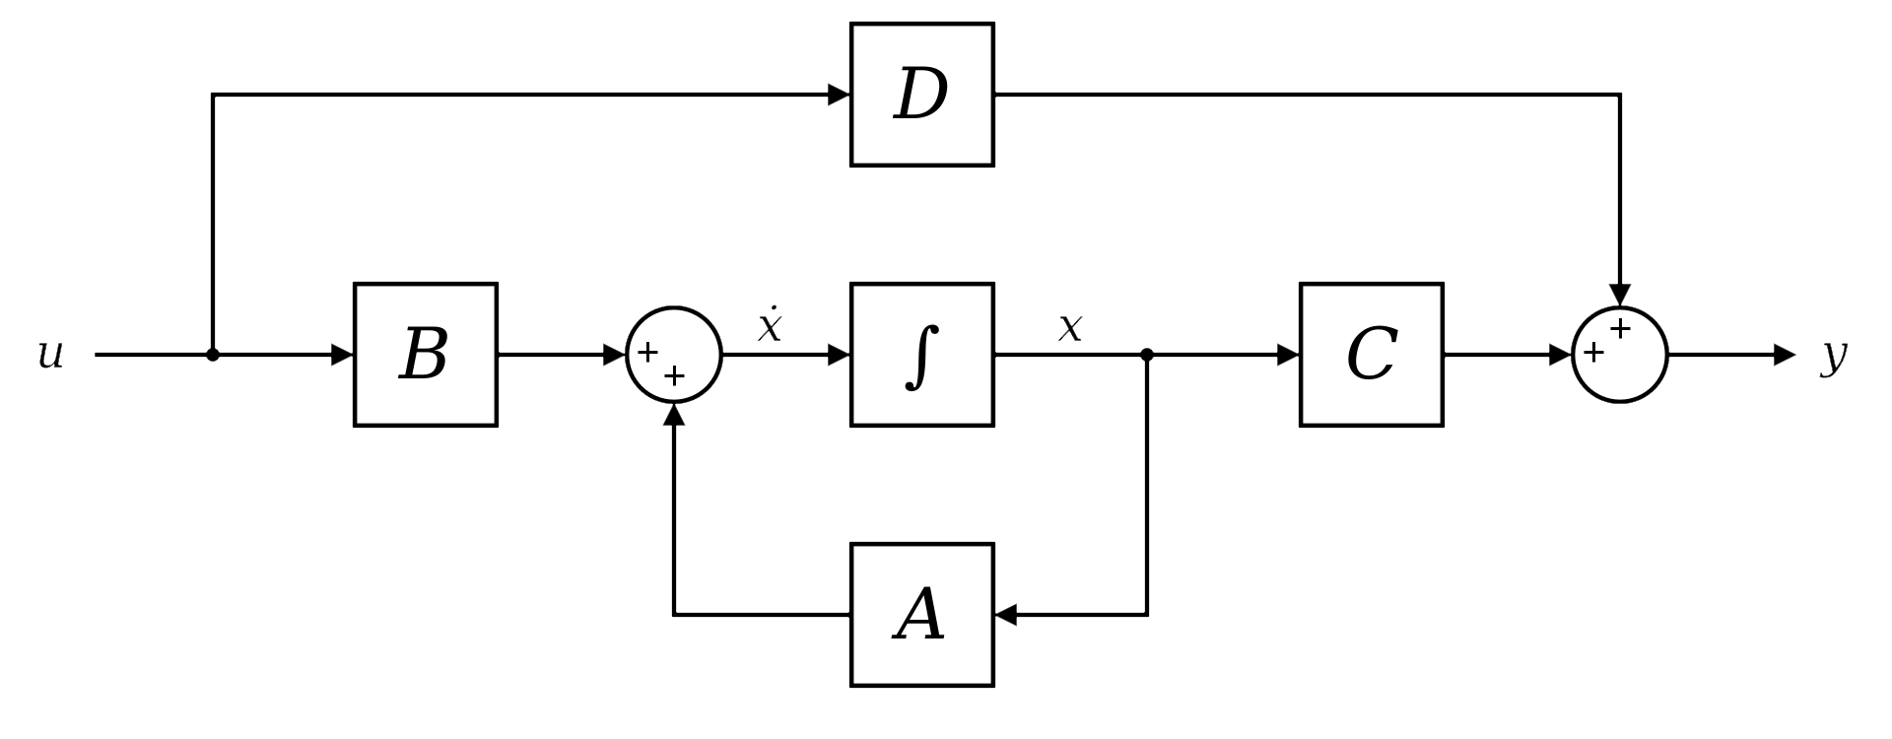
SSM
Intelligent Control Systems: An Introduction with Examples
State-space representation → State Space Model

Slide 17
Mamba

Slide 18
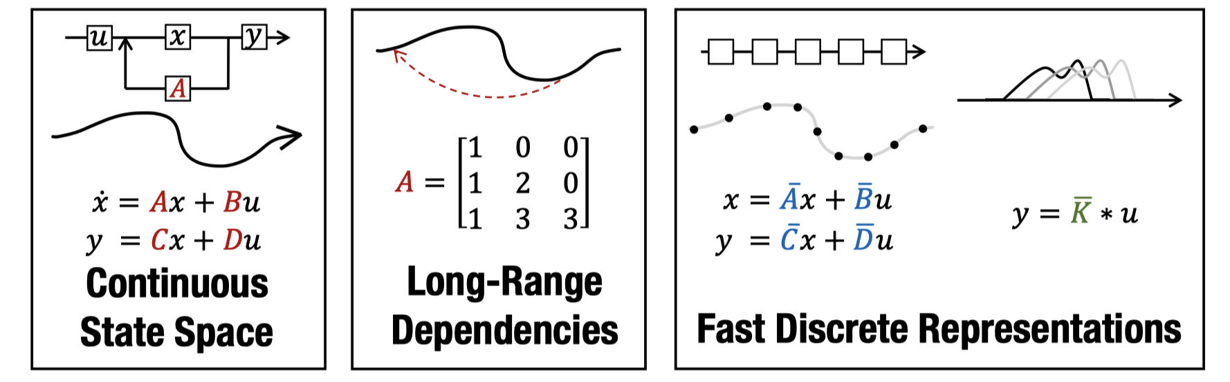
S4
Paper: Efficiently Modeling Long Sequences with Structured State Spaces
aka. Structured State Space sequence model (S4)

Slide 19
Mamba

Slide 20
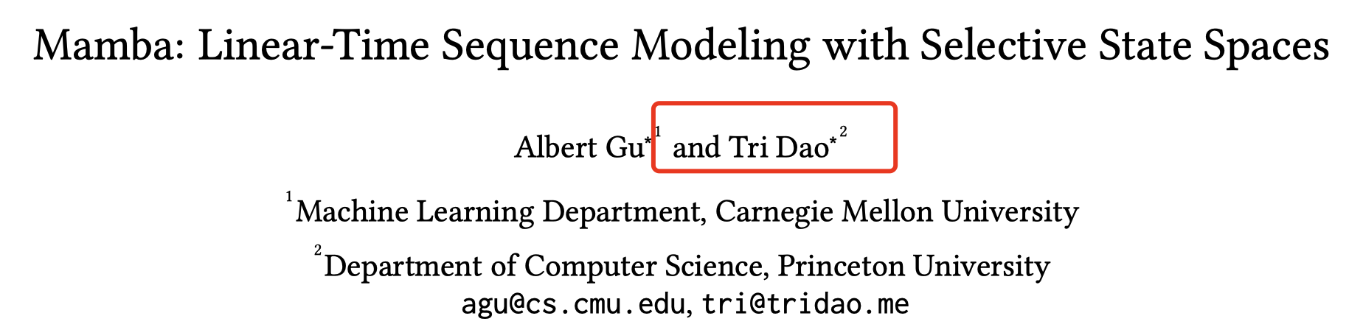
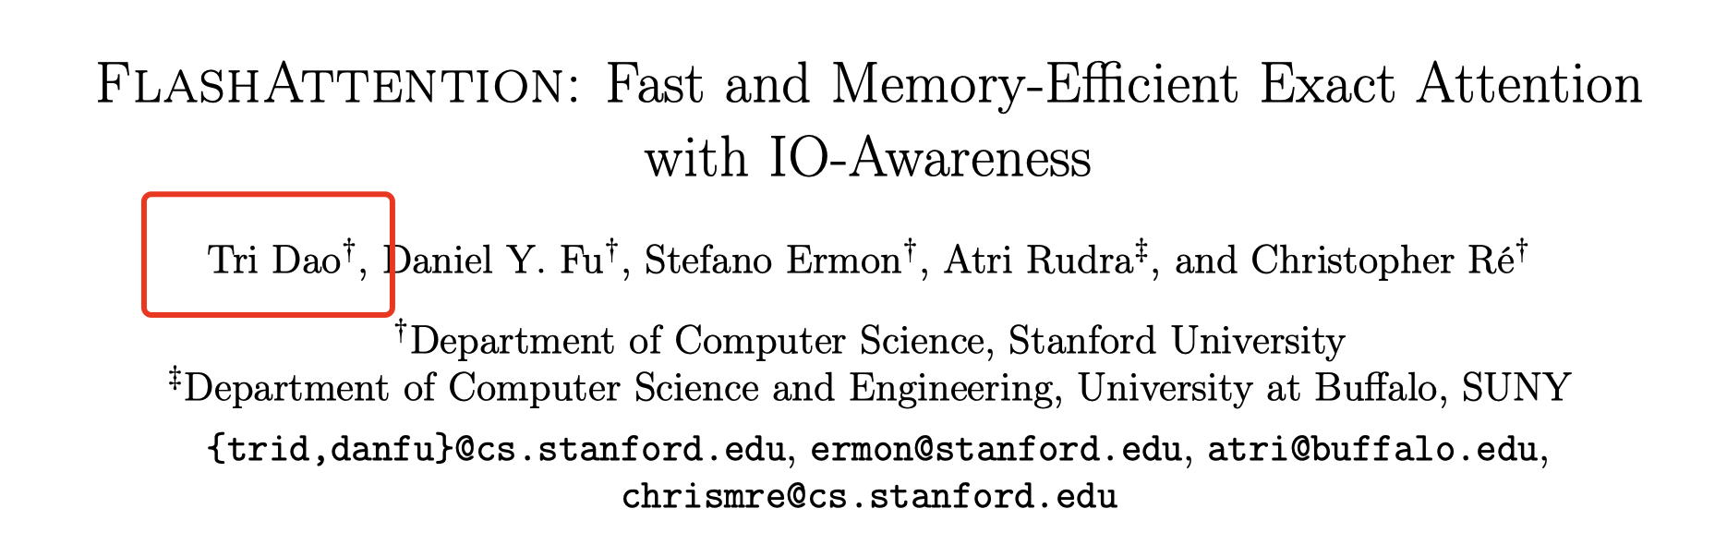
mamba

Slide 21
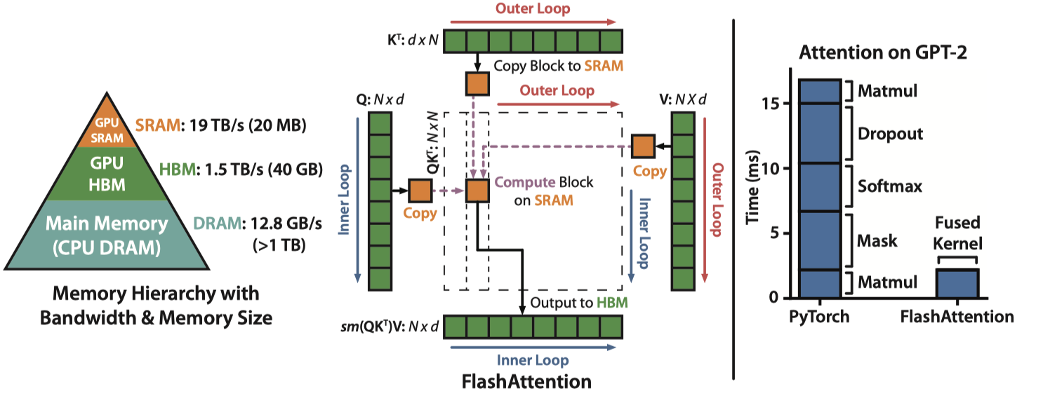
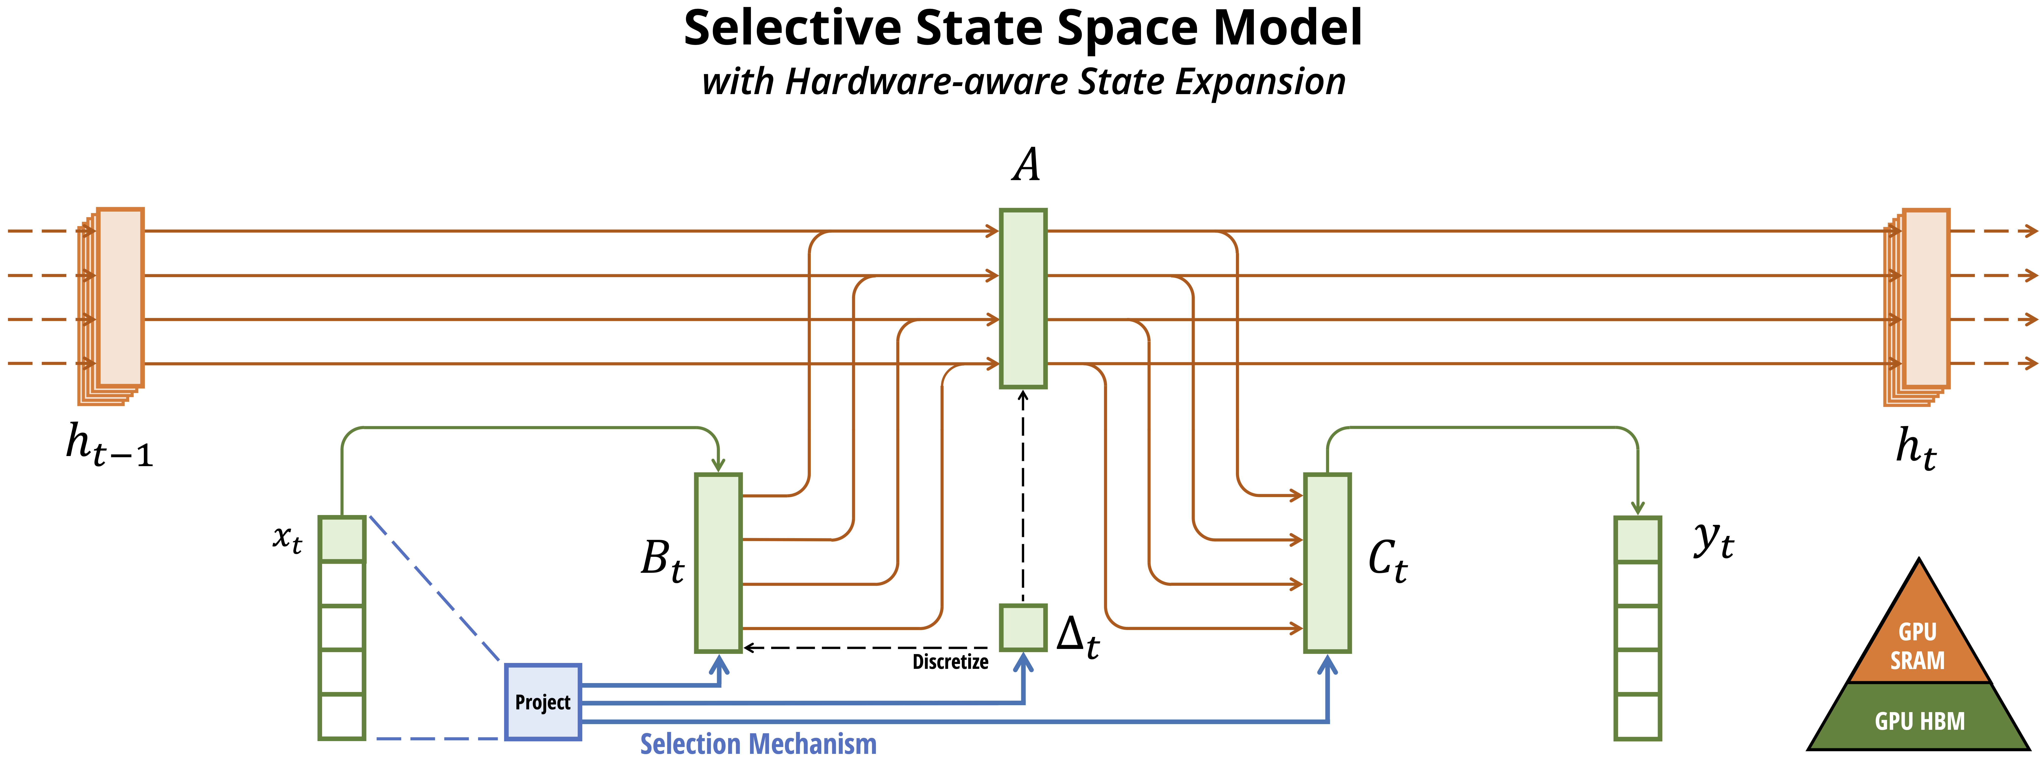
mamba

Slide 22
Mamba

Slide 23
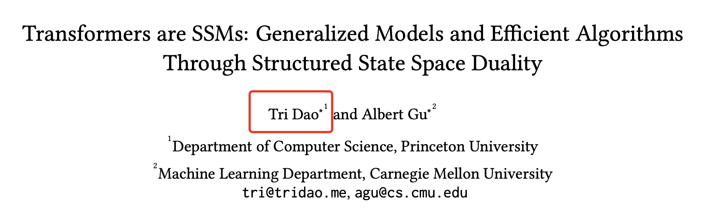
mamba2

Slide 24
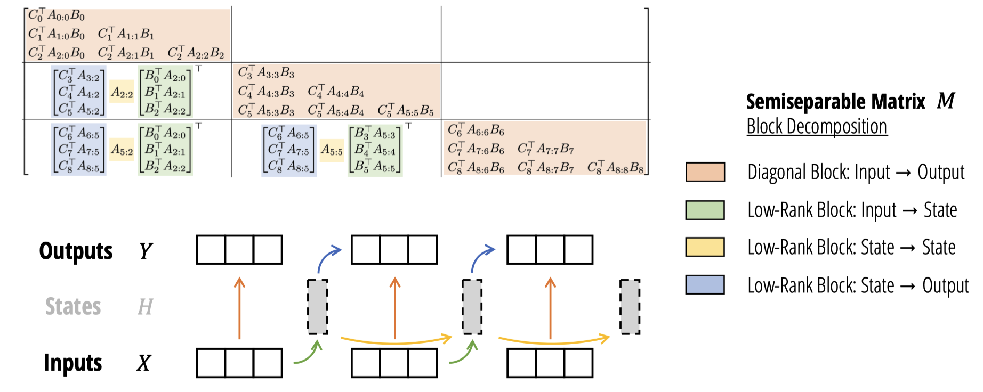
mamba2

Slide 25
Reference 参考&引用
https://srush.github.io/annotated-s4/
https://huggingface.co/blog/lbourdois/get-on-the-ssm-train
https://en.wikipedia.org/wiki/State-space_representation
https://arxiv.org/abs/2405.21060
https://github.com/state-spaces/mamba?tab=readme-ov-file

Slide 26
03
小结与思考

Slide 27
